Slide 1


KLPG Meeting
January 23, 2024
Hotel Topeka at City Center

Slide 2
What is KCAMP?
Interlocal agency formed under Kansas statute allowing public entities to jointly self-insure their property and casualty risks
Regulated by the Kansas Insurance Department
Not an insurance company - separate statutes / regulations apply

Slide 3
Mission Statement
The mission of the Kansas County Association Multiline Pool is to deliver high quality coverage and risk management services to its members in a manner which provides long-term financial stability, minimization of risks and protection of mutual interests.

Slide 4

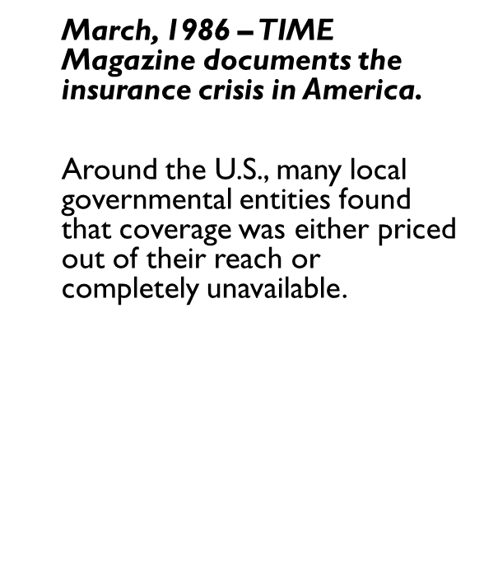
History

Slide 5
Why Pooling?
Program Advantages
Pooling allows public entities to:
Share cost of risk among similar entities
Determine scope/terms of own coverage
Control claims and litigation management
Reap benefits of group purchase
Tailor risk control programs
Member oversight of program equity

Slide 6
Pooling vs. Commercial Insurance
80% of public entities (over 90,000) obtain coverage from a risk pool
Member-owned, Member-funded, Member-Directed
Not Profit-driven – Goal is to contain and stabilize costs
All programs designed to mitigate and manage risk and exposure for Kansas public entities

Slide 7
KCAMP Overview
Formed in 1991 – over 30 years as the leading provider of property and casualty coverage and services to Kansas municipalities
Began with 37 Counties
Today 78 of the 105 counties are members – plus 10 city members and 22 other municipality members
Broad, tailored coverage
Prudent limits
Low stable rates
Extensive risk management services
Strong net asset position

Slide 8
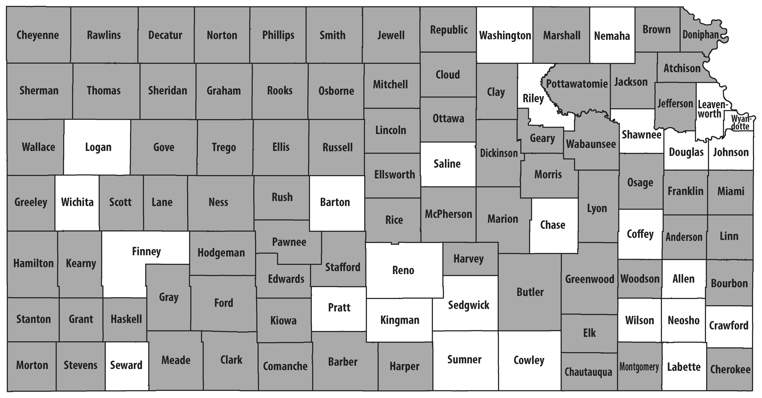
County Membership
2024 County Members (shaded)

Slide 9
MEMBERSHIP GROWTH

Slide 10
KCAMP Governance
7 Member Board of Trustees
Elected by the Members
Serve 3-year terms
Board elected officers:
President
Vice-President
Secretary
Financial Controller
Claims Controller
Committees:
Executive
Financial/Audit
Investment
Nominating

Slide 11
Board of Trustees
John Smith, President (Stanton County Commissioner)
David Lamb, Secretary (Linn County Clerk)
Keith Becker (McPherson County Commissioner)
Note: Board elected to three-year terms by membership. Officers elected by Board to one -year terms.
Sarah Rains, Vice-President (Hodgeman County Clerk)
Justin Clark, Financial Controller (Woodson County Commissioner)
Kendal Lothman, Claims Controller (Kiowa County Sheriff)
Dawn Harlow (Lincoln County Clerk)

Slide 12
KCAMP Staff
(Topeka)
David M. Luke, JD, ARM Administrator/CEO
Susan Flynn
Executive Assistant
Maura Chambers, ARM, AIC
Deputy Administrator
Reed McGregor, AIC, AIM
Claims & Litigation Manager
James Gambrell, AIC, CLU
Senior Claims Representative
Lauren Lewis, AIC
Claims Representative
Sheriff Ed Harbin (Ret)
Law Enforcement Specialist
Yana Ross
Risk Manager
Robert Taylor, CPCU, ARP, AIS
Underwriting Manager

Slide 13
Coverage Lines
General Liability
Automobile Liability
Law Enforcement Liability
Public Officials’ Errors and Omissions Liability
Employee Benefits Liability
Professional Liability for Nurses and EMTs
Cyber Liability
Property Including Flood, Earthquake and Terrorism
Equipment Breakdown
Crime
Surety

Slide 14
Tailored Coverage –
Liability
Liability
Higher Liability Limits for Non-KTCA Claims
Additional Defense Costs Outside the Limits
No Aggregate Limits on Liability for General Liability, Law Enforcement Liability and Automobile Liability Coverages
Crisis Response Coverage Included
Sub-limited Coverage for Injunctive Relief Claims

Slide 15
Tailored Coverage -
Property
Property -
“All Risks” Coverage
Replacement Cost on Buildings & Contents
Physical damage coverage (ACV) on all vehicles and equipment regardless of age
Automatic coverage for property, vehicles and equipment purchased mid-year at no charge (valued under $2.5MM)
Flood, Terrorism and Earthquake coverage included
First and Third-Party Cyber Coverage with prudent limits of protection

Slide 16
2024 Property Program Structure
Limits | Equipment Breakdown $50MM Sublimit | Earthquake $5MM Sublimit | Flood $10MM Sublimit ($1MM for SFHA Locations) | All Other Perils
$1 Billion |  | Multiple Lloyds and Bermuda Syndicates xs $30MM
$30,000,000 |  | CRL Property Plus $25MM xs $5MM
$5,000,000 |  | County Reinsurance Limited (CRL)
$350,000 |  | KCAMP $350,000 Retention
 | Standard Member Deductibles: All Other Perils - $5,000; Equipment Breakdown - $5,000; APD & Mobile Equipment - $2,500 Convective Storm - $10,000 ; EQ - $10,000 ; Flood SFHA Flood Locations – Lesser of available NFIP Limit or $500,000

Slide 17
2024 Liability Program Structure
 | General Liability | Automobile Liability | Public Officials Liability | Law Enforcement Liability | Limited Professional Liability (Nurses/EMTs) | Cyber Liability $1MM Limit
$3,000,000 (Limit for Claims Not Governed by Kansas Tort Claims Act)
$500,000 Limit for Claims Governed by Kansas Tort Claims Act
 | Member Deductibles range from $0 to $10,000 for Public Officials and/or Law Enforcement Liability. Cyber Liability member retention is $10,000. Sexual Abuse Molestation limited to $500,000 each occurrence – no defense costs outside the limit.
County Reinsurance Limited (CRL)
$2.5MM xs $500,000
($500,000 Additional Payments Provision)
KCAMP
$500,000 Pool Retention

Slide 18
2024 Crime Program Structure

Slide 19
Property Rate Trend: 2011 to 2024
Note: Contributions are exclusive of member contributions credits.

Slide 20
Liability Rate Trend: 2011 – 2024
Note: Contributions are exclusive of member contributions credits.

Slide 21
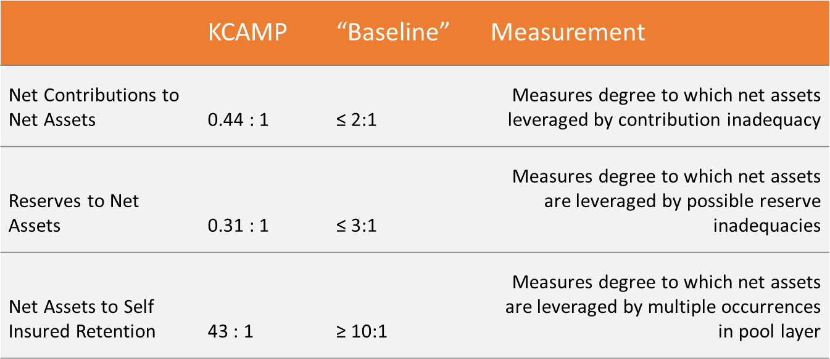
Surplus or Leverage Ratios*
*Based on 2022 Audited Financial Report
Members’ Fund Balance of $21,605,345
Returned over $1.8MM to our members in the form of dividends and contribution credits since 2012

Slide 22
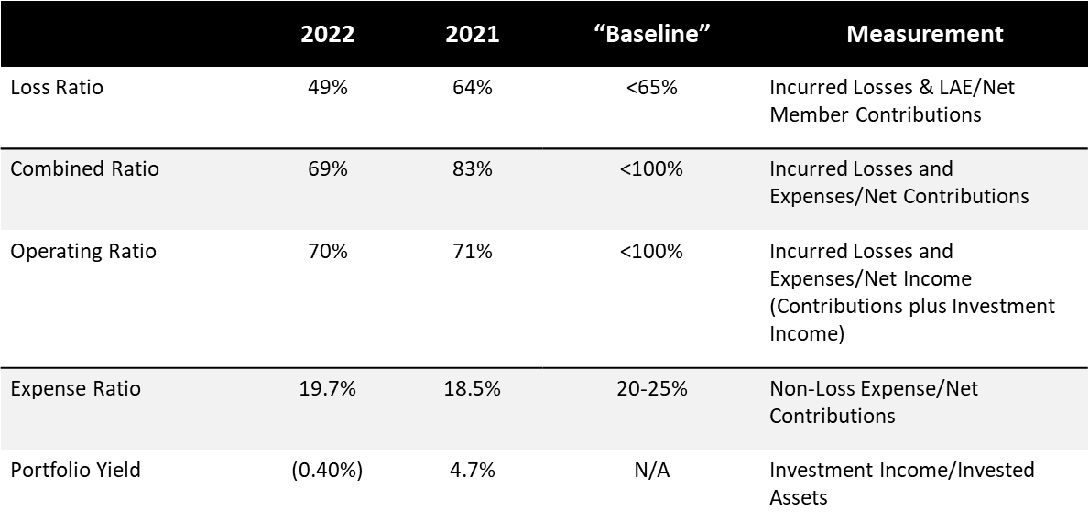
Profitability Ratios*
*Based on 2022 Audited Financial Report

Slide 23




Member Resources
Attorney Assist
Contract Review
eRiskHub®
Sample Employee Handbook
Unlimited access to legal advice for liability-related issues.
Unlimited assistance in developing indemnity and insurance requirements in contracts, reviewing certificates of insurance or drafting waivers.
Exclusive access to a wealth of online cyber-security information, including sample policies, self-assessment tools, and training.
Customizable written employment best practices addressing recruitment, hiring, leave, termination, discrimination, harassment and other employment matters.

Slide 24




Member Resources
ThinkHR
KCAMP Online University
Law Enforcement Resources
On-Site/Virtual Training/Seminars
Unlimited access to live consultation with senior-level human resources professionals, compliance guidelines, best practice recommendations, an employee handbook builder, and self-audit tool.
Unlimited access to a broad range of web-based training. Supervisors receive detailed documentation of completed courses.
Model policies that are continually updated to maintain compliance with federal and state statutes and case law.
Jail Guidelines – up-to-date legal standards for jail operations, including key word search and a self-audit tool.
Training upon request by KCAMP professionals on a variety of risk management topics, including defensive driving, employment practices and law enforcement.

Slide 25




Risk Management Incentive Programs
Roads Scholar Tuition Reimbursement
Risk Avoidance Grant
Risk Management Awards
Loss Ratio Awards
Reimbursement of a portion of the cost per employee to complete courses under the Kansas Roads Scholar Program.
Reimbursement of up to $2,000 annually per member for purchases of products or services that help reduce property or liability losses.
Reimbursement of a portion of the member’s annual contribution for implementing certain loss mitigation measures.
Annual awards to members with the lowest loss ratios.

Slide 26
Risk Management Overview
→
→
→
→
KCAMP Online University
Defensive Driving Training
In-Person Road & Bridge Training
Roads Scholar Tuition Reimbursement
Public Works
Cyber Security Risks
Property Risks
Law Enforcement Risks
Jail Operations Risks
Human Resource Risks
Contractual Risk
←
←
←
←
Loss Control Inspections
Boiler Inspections
Property Appraisals
Fleet Safety Model Polices & Procedures
eRisk Hub
→
KnowBe4
→
KCAMP Online University
Defensive Driving Training
Model Law Enforcement Policies/Procedures (LLRMI)
←
←
←
→
→
KCAMP Online University
Kansas Legal-Based Jail Guidelines
Contract Review & Development
Risk Transfer Consulting
Customizable Facilities Use Agreements & Waivers
←
←
←
→
→
→
→
KCAMP Online University
Attorney Assist
Customizable Employee Handbook
Mineral (formerly ThinkHR)

Slide 27
Questions?
Please contact us!
David Luke, Administrator/CEO
835 SW Topeka Boulevard
Topeka, Kansas 66612
1-800-240-9828 (Toll-Free)
785-215-8503 (O)
785-338-1504 (C)
davidluke@kcamp.org
www.kcamp.org

