Slide 1
KDOT Innovations Program Update
Cory Davis
Director, Division of Multimodal Transportation and Innovation
Mitch Sothers
Chief, Bureau of
Innovative Technologies

Slide 2

Agenda
Innovations in KDOT Right-of-Way
  Transportation Solutions
  Broadband Expansion
Innovative Technology Program Overview

Slide 3
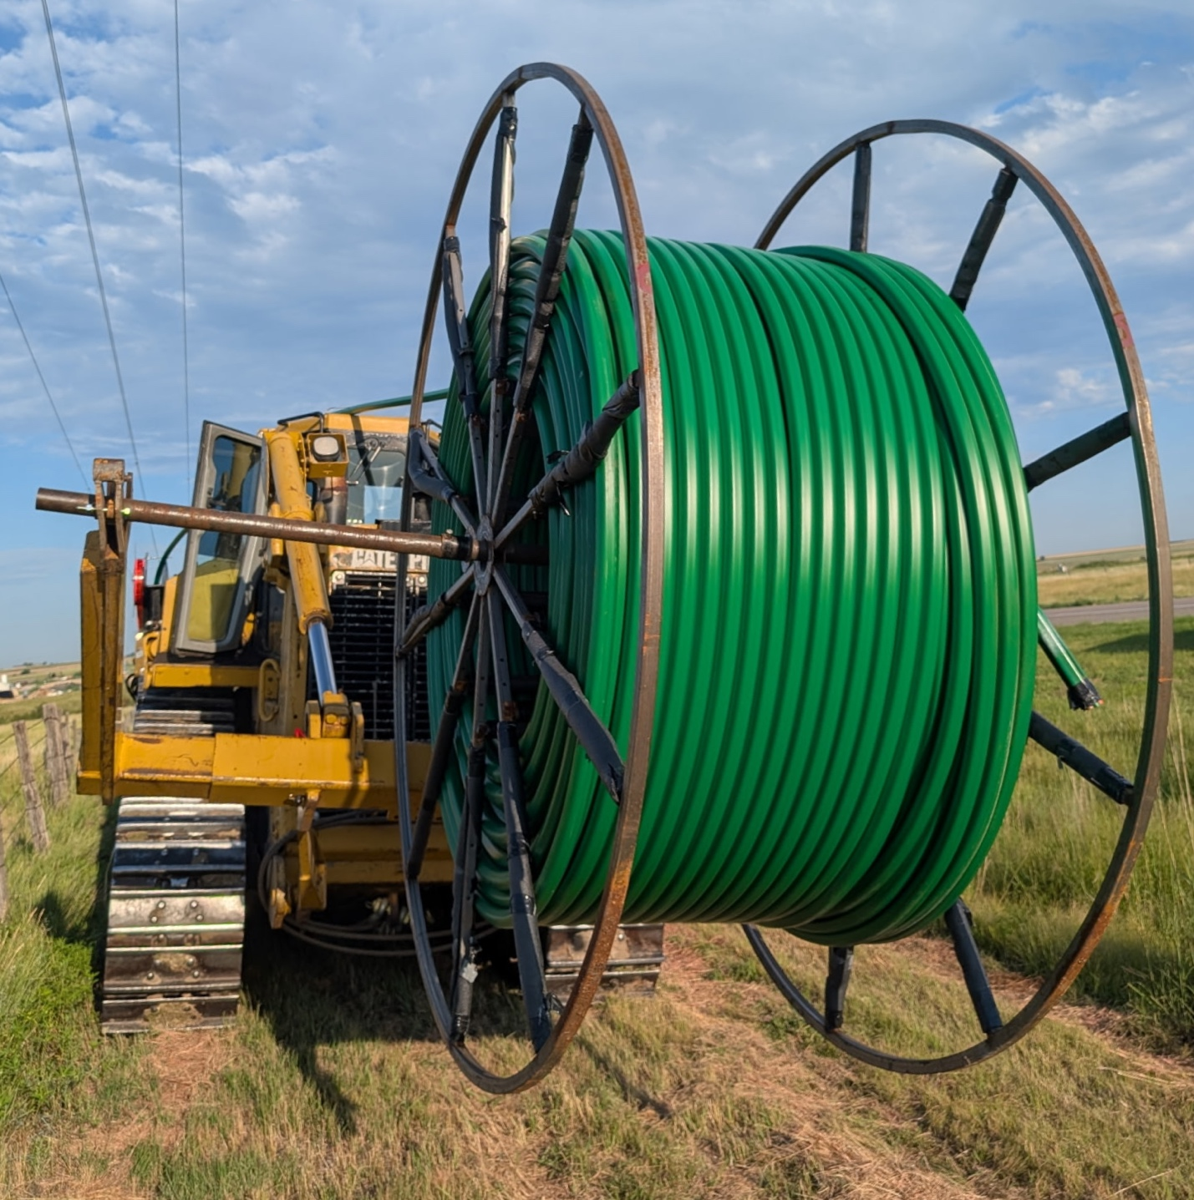
Innovative Connected Technologies
State Fund Set-Aside
Focus on Installation of Conduit and Fiber within KDOT Right-of-Way
  Funded at $10 Million per Fiscal Year
  Intelligent Transportation Systems
  Future Innovative Transportation Solutions
  Provide Infrastructure for Broadband Expansion
  Leveraged IKE Funds to Receive Federal Funds
  Broadband Policy
Notes:
Provide more detail on the infrastructure we are putting in the ground. 7-way microduct in our ROW. We view our ROW as a real asset for expanding broadband. The 7-way microduct provides opportunity for both expanding transportation technologies, but also broadband expansion. KDOT plans to utilize two of the 7 ducts for transportation purposes, while the remaining 5 can be utilized by internet service providers to provide more broadband connectivity across the state.

Slide 4
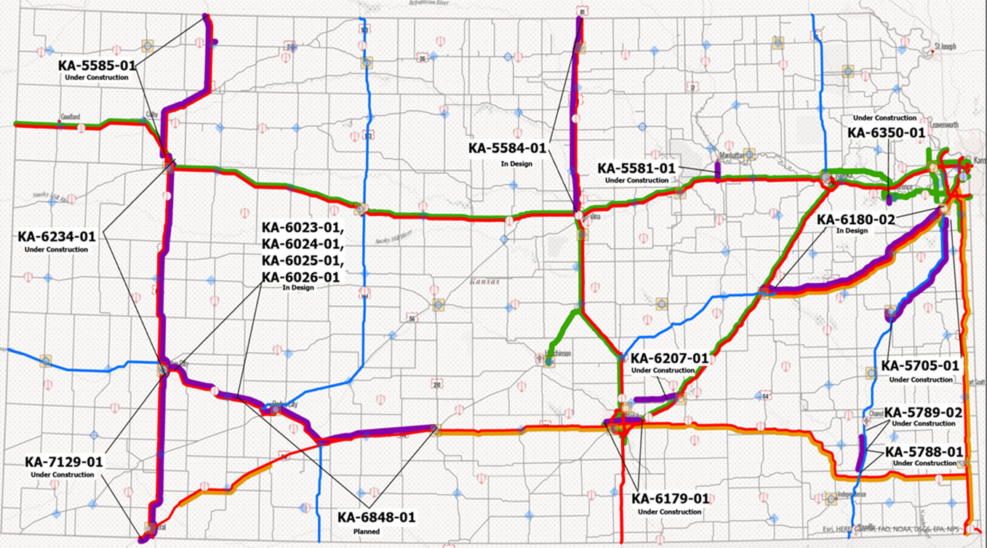
Notes:
Where are we putting this infrastructure? We are currently prioritizing our freight routes of significance for the location of this infrastructure. These are generally our higher volume routes, and the transportation technologies we can leverage will support more efficient freight movements throughout the state. Discuss map, number of projects, introduce Middle Mile. Point out that these funds have been programmed through 2029. All but one year of IKE funding has been programmed.

Slide 5
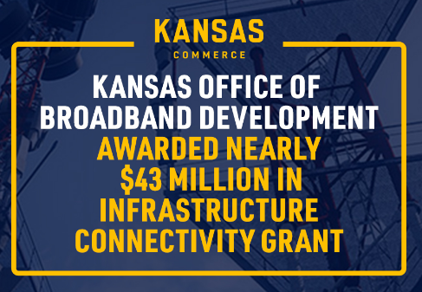
Innovative Connected Technologies
State Fund Set-Aside
Partnered with Kansas Department of Commerce and Other Partners to Apply/Receive a Middle Mile Grant
Leveraged State Funds to Receive Federal Funds - $26M Match $43M Federal Funding
Approximately 533 Route Miles of Conduit and Fiber and 105 Miles of Blown Fiber in Existing KDOT Conduit
Notes:
Enabling Middle Mile Broadband Infrastructure (EMMBI) Program as Administered by the National Telecommunications and Information Administration (NTIA) and Focused on the Construction, Improvement, or Acquisition of Broadband Middle Mile Infrastructure.
Important note: The additional federal funding has allowed KDOT to invest in substantially more miles of conduit than the original $100M would allow.

Slide 6
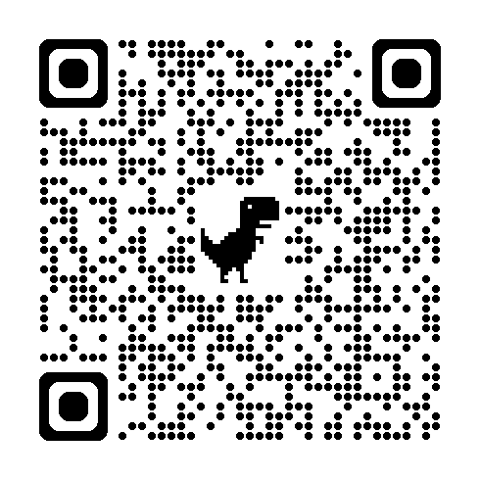
Kansas Broadband Acceleration Grants (BAG)
Broadband Infrastructure Construction Grant Fund
$85M over 10 years Provided Through IKE Broadband Modernization Funding
Administered by Commerce OBD
Grants Funds up to 50/50 Cost Share
Provide High-Quality, Reliable Broadband Infrastructure to Unserved, Economically Distressed Communities and Areas of Compelling Need
Last Mile
Notes:
Outline the successful partnership between the two agencies. Both the BAG partnership and the Middle Mile partnership. The Middle Mile project illustrates success in leveraging state funds to receive additional federal funds. Middle Mile directly supports the BAG program as it provides the long haul network needed for the last mile connections.
Important note: The additional federal funding has allowed KDOT to invest in substantially more miles of conduit than the original $100M would allow.

Slide 7
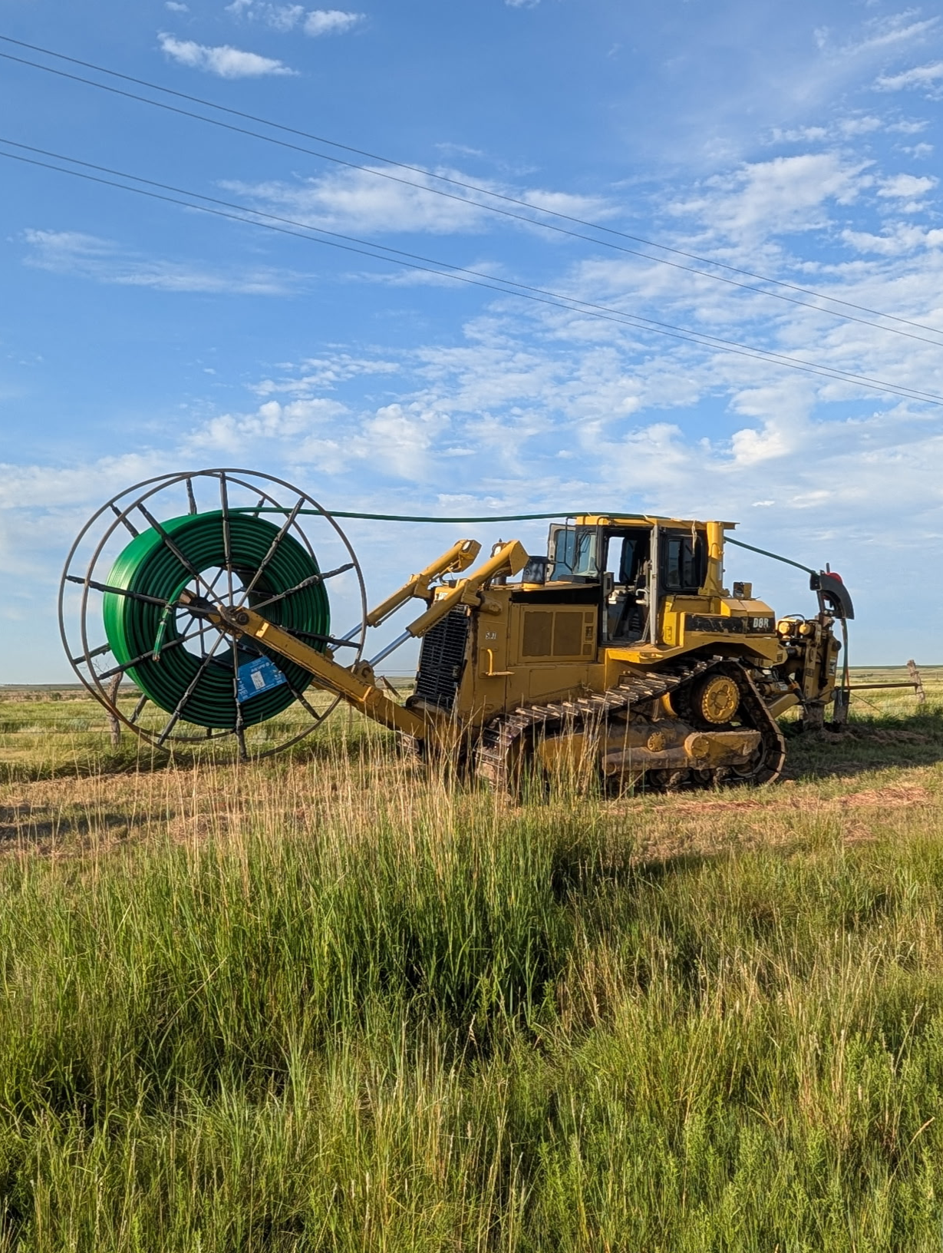
Dig Once Strategy
Add Conduit/Fiber to an existing KDOT project:
  Preservation +
  Efficiency in the design process
  Efficiency in the construction process
Public Private Partnership
  Shared Cost of Design and Construction
  Shared Trench
  Shared Conduit

Slide 8

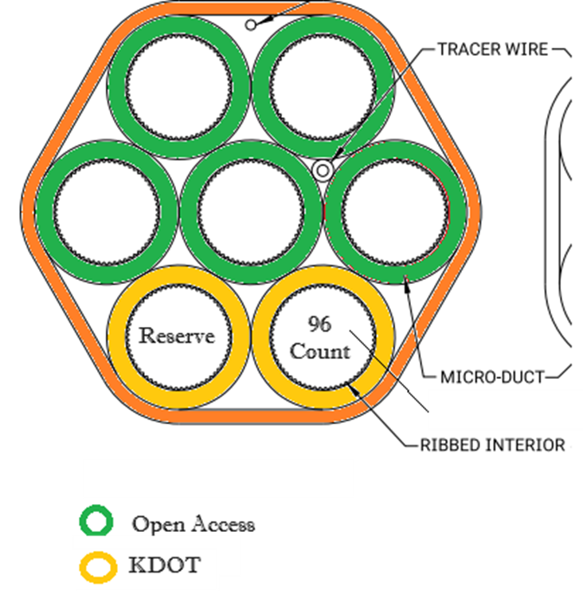
Broadband Policy
Expand Broadband in Rural Areas
Partner with Internet Service Providers
Revenue for Operation and Maintenance
Expansion of the Network
Fair and Equitable Leasing
Clean up Right-of-Way

Slide 9
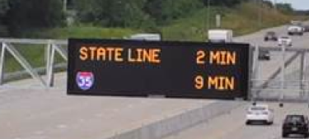
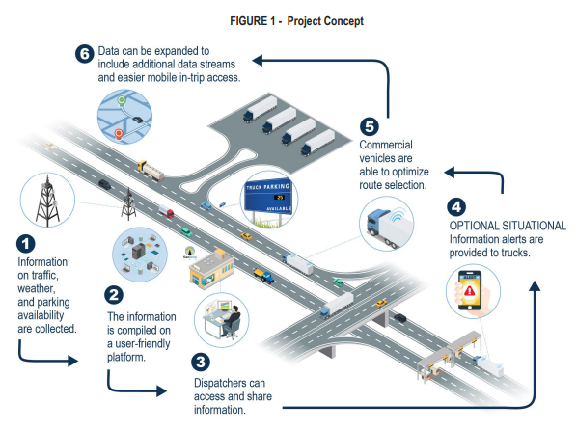
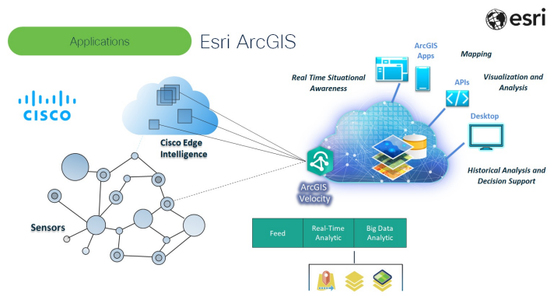
Technology Network
Real-time alerts
Long-term decision support
Notes:
Earlier, I mentioned transportation benefits, so I want to briefly describe what that may look like. As we advance towards a more connected transportation system we will have the opportunity to leverage these fiber assests to provide intelligent transportation solutions (real-time alerts, dynamic messaging). This is already happening where we currently have fiber and this program will look to expand those opportunities. This will also set Kansas up for future connected vehicle opportunities. This can provide KDOT with data that can help support decision making. We can more accurately understand what is happening on our roadways and make more informed decisions. (Example: If we have a segment of roadway that is consistently showing harsh braking events, or lane departures, we can address that through a countermeasure such as signage and or roadway improvements.)

Slide 10
Outcomes
Setting Kansas up for the future of transportation
  Intelligent Transportation Systems
  Connected Vehicle Solutions
  Safety Improvements
Expanding broadband throughout Kansas
  Long haul capabilities with the 7-way conduit
  Last mile connectivity through Broadband Acceleration Grants
Notes:
Ultimately our goal is to set up Kansas for the future of transportation and expand broadband all while leveraging our existing assets, our ROW, and adding one piece of additional infrastructure, our conduit.

Slide 11
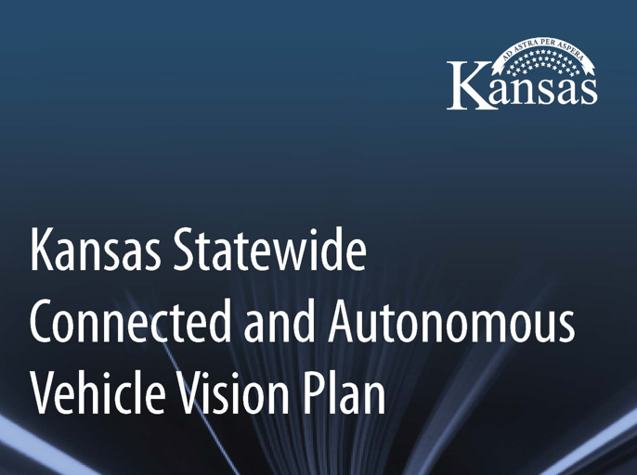

Slide 12
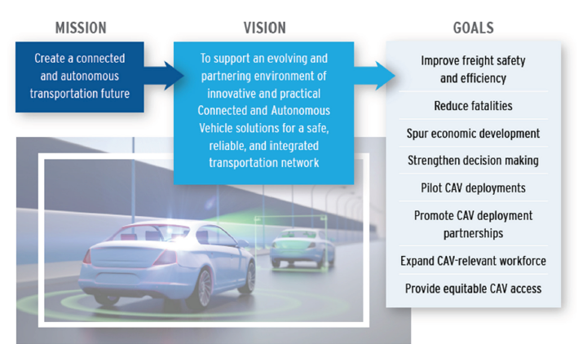

Slide 13
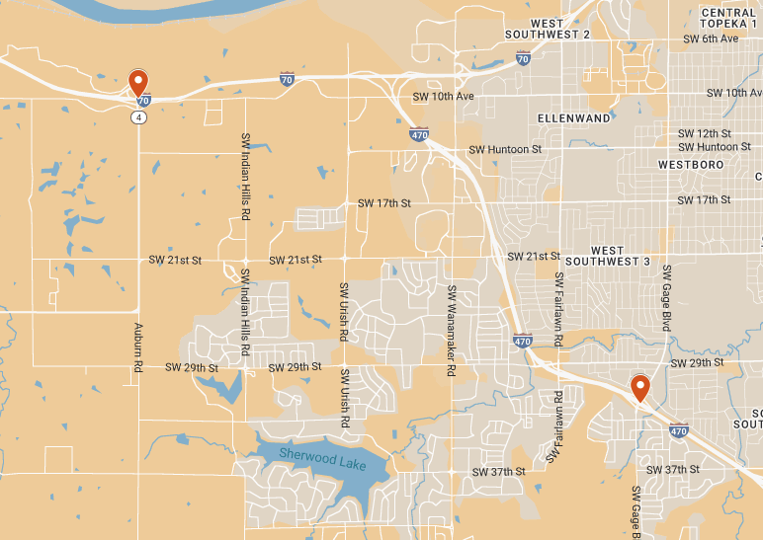
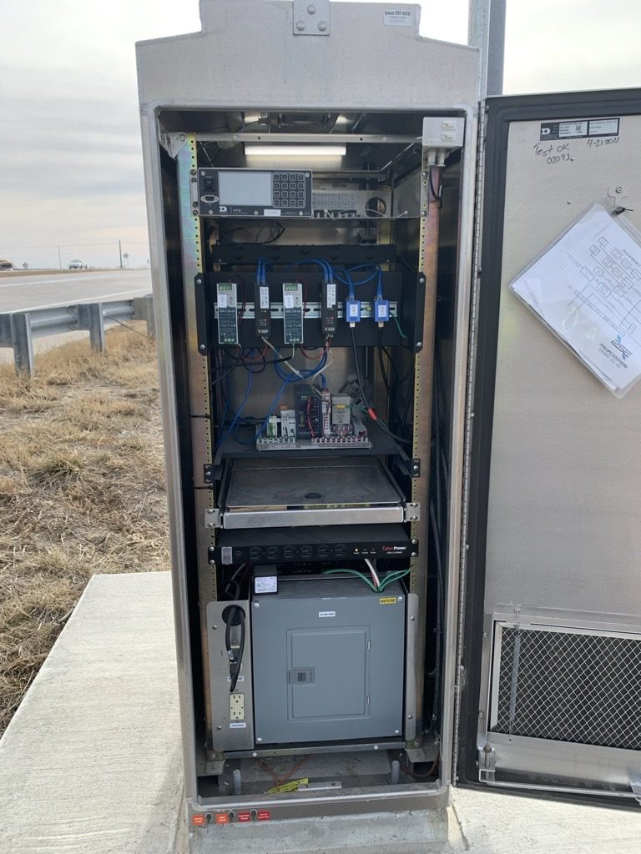
Connected Vehicle Proof of Concept
Roadside Units
Connected Vehicle Data Collection
Data Visualization
Determining the Data we Need
Understanding our Infrastructure
Includes Wind Warning and Truck Tip-Over Use cases
Notes:
This proof of concept project is located in more urban areas whereas the Rural Freight Technology Project is located in a rural area.

Slide 14
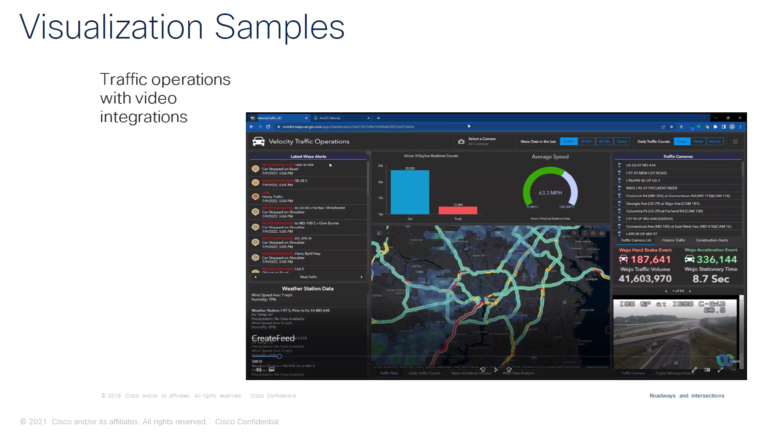
Notes:
Currently working on the Proof of Concept dashboard and how it will look for KDOT.

Slide 15
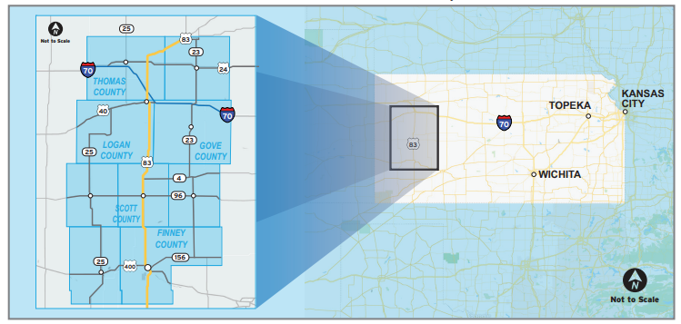
Great Plains Rural Freight Technology Corridor Project – US-83
$14 Million Project
Federal Award - $6.7M
KDOT Installs Fiber
Federal funds provide technologies

Slide 16
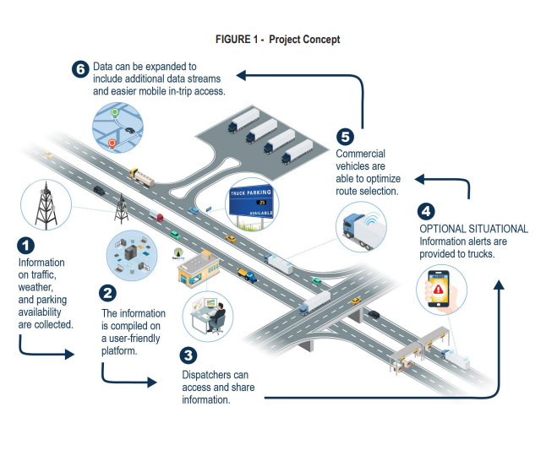
US-83
Traveler Information
Transportation Management Technologies
Infrastructure Maintenance
Advanced Safety Systems
Data Collection
Notes:
02 phase of the project is letting later this month

Slide 17

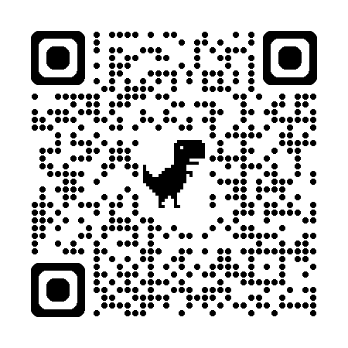
Display oversized truck locations (U.S. 83 Corridor only)
Alerts on high wind, low visibility and ice/snow road conditions
Operate on Amazon Alexa home speaker and app
Integrate with Android Auto and Apple CarPlay
Enhance detour information
Improve sharing of information for work zones
Notes:
Voice alerts, hands free operation, allows user to report concerns

Slide 18
Innovative Technology Program Updates

Slide 19
Innovative Technology Program
(Transportation Technology Development State Fund Set-Aside)
New Program Manager
  Michael Flory
  Michael.Flory@ks.gov
  785-296-0937

Slide 20
Innovative Technology Program
(Transportation Technology Development State Fund Set-Aside)
$20 Million Eisenhower Legacy Transportation Program (IKE) Initiative
  Leverage Innovative Technology Investment Opportunities to Position State for the Future
  Provide Financial Assistance to Partners for Projects that Promote Safety, Improve Access or Mobility and Implement New Transportation Technology in the Local Community of the Project

Slide 21
Innovative Technology Program
(Transportation Technology Development State Fund Set-Aside)
Funding / Match Requirements
  $2 Million Available Per Fiscal Year
  Maximum of $1 Million Per Project
  Funds are for Reimbursement Only
  A Minimum of 25% Non-State Cash Match Required
  Non-Cash Local Matches Will Not Be Considered

Slide 22
Innovative Technology Program
(Transportation Technology Development State Fund Set-Aside)
Eligible Applicants
  Projects typically will be administered by a local unit of government
  Non-governmental applications with a local government partner will also be considered
  Educational institutions may apply without any partners necessary
Notes:
If you look at past grant recepients, you will see a combination of all of these.

Slide 23
Innovative Technology Program
(Transportation Technology Development State Fund Set-Aside)
Eligible Projects
  All Transportation System Projects are Eligible Including Roadway (on and off State System), Rail, Aviation, Unmanned Aerial Systems (UAS), Bike/Ped, Transit, Software and Technology Infrastructure
  Innovative Technology is Defined as Any Technology Not Currently Existing in the Local Community of the Project
  Candidate projects should include projects not eligible for other KDOT programs
  Additional Consideration Given to Projects that Improve Safety, Support Economic Growth, Retention or Recruitment of Business, Add Value to a KDOT Project

Slide 24
Innovative Technology Program
(Transportation Technology Development State Fund Set-Aside)
How to Apply
  Following the Summit, Submit a Project Concept Form
  Once KDOT has Reviewed Concepts, an Application will Sent
  All KDOT Innovative Technology Program Applications/Attachments Must be Submitted as a Single PDF Document via email to InnovTechProgram@ks.gov
  Applications will be Reviewed by KDOT Innovative Technology Committee

Slide 25
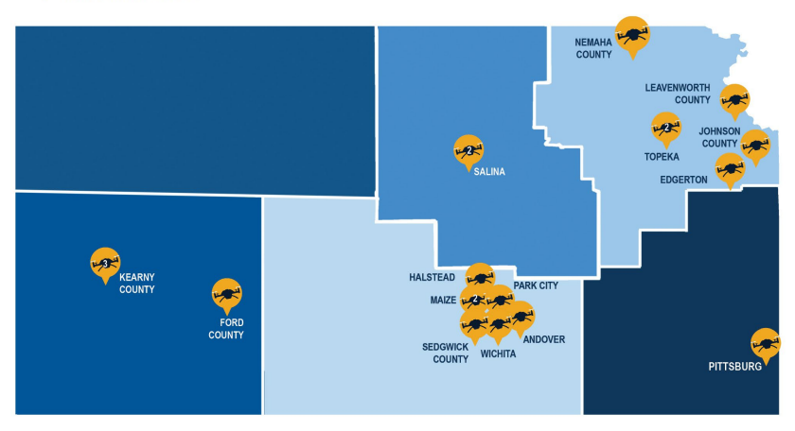
Innovative Technology Program
(Transportation Technology Development State Fund Set-Aside)
Fall 2024/Spring 2025 Awardees
  20 Awardees; $4.5M State funds; $5.97M Total Project Cost
  Highlight of Selected Projects
    Autonomous Agriculture Vehicle Pilot
    Blocked Rail Crossing Alert System Pilot
    Improving Multi-modal Safety Using Advanced AI
    Pavement Management/Assessment App Using AI (5 projects)
    Advanced Aviation and Engineering Research Operations (UAS/AAM)
    VIN Inspection Program Modernization
Notes:
$4.5M?? You said $2M/ year?? Explain that previous years had funds left unencumbered and KDOT is trying to catch up on spending those unencumbered funds. It is likely that the same will be true for the next program year, so submit concepts.

Slide 26
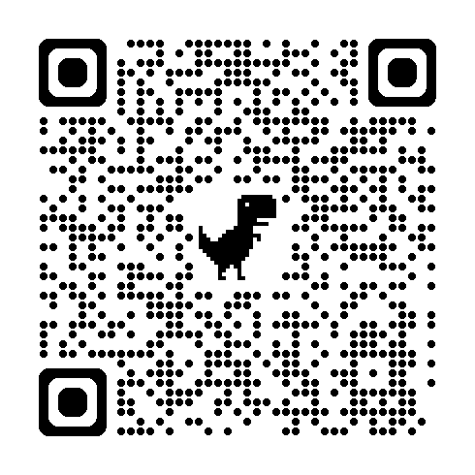
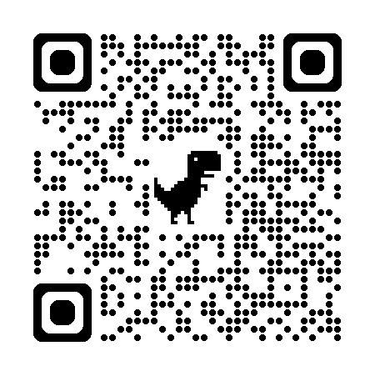
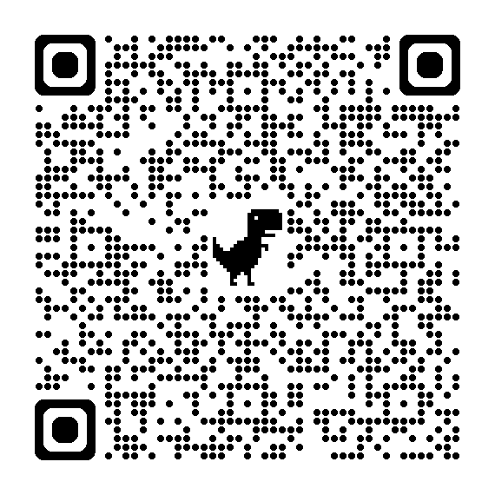
Innovative Technology Program Web Page
Fact Sheet
Concept Submittal Form

Slide 27
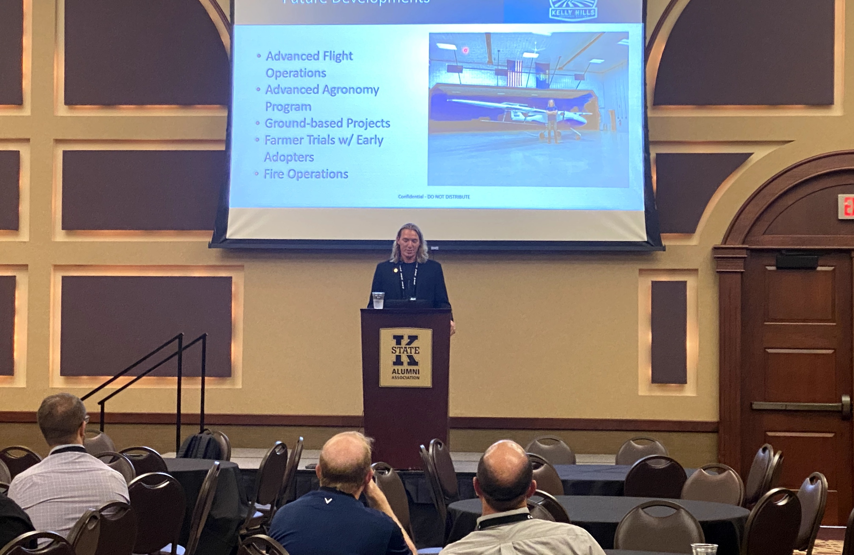
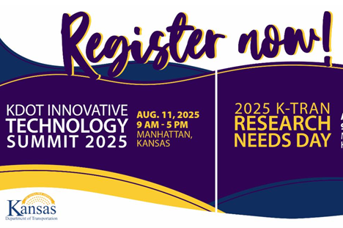

Innovative Technology Summit
Join us next year!

Slide 28
Questions?
William “Mitch” Sothers, P.E.
Chief, Bureau of Innovative Technologies mitch.sothers@ks.gov

