Slide 1
State of Kansas
Rural Health Transformation Plan
Dr. Bob Moser, M.D.,
Medical Director
The University of Kansas Health System Care Collaborative
This program is supported by the Centers for Medicare & Medicaid Services (CMS) of the U.S. Department of Health and Human Services (HHS)
as part of a financial assistance award totaling $221,890,000 with 100 percent funded by CMS/HHS.
The contents are those of the author(s) and do not necessarily represent the official views of, nor an endorsement, by CMS/HHS, or the U.S. Government.

Slide 2
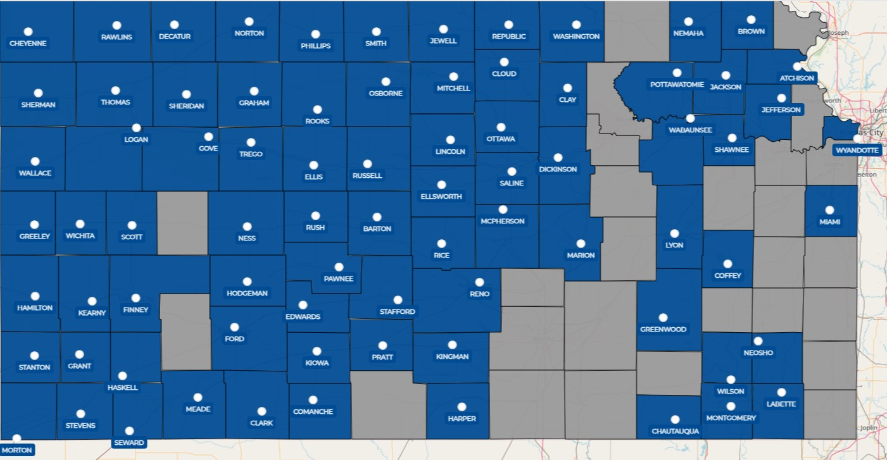
The Care Collaborative
Started in 2014 to help move evidence-based guidelines into practice with rural partners and support rural health systems. Now with 91 members across 79 counties
Notes:
Through Q1 2024

Slide 3
Rural Health Transformation Program
$50 billion included in One Big Beautiful Bill Act to transform rural healthcare delivery
  $10 billion to be distributed to states each year for 5 years, not individual providers
  To receive funds, states were required to submit a proposed Rural Health Transformation Plan and related budget consistent with Program Requirements – a 5-year plan
Kansas awarded $221.89 million in Year 1 to implement its approved Plan
  Awards ranged from $147.3 million to $281.3 million; Kansas’ award was the 6th highest of any state
  Award amounts based on specific objective criteria + quality of State’s Plan
Instead of receiving lump sum payment, State draws down federal funds for approved expenditures included in the budget submitted with our State plan
The amount of future awards depends on State’s progress in Plan implementation

Slide 4

Kansas Plan Objectives
Realize meaningful reductions in chronic disease rates and avoidable hospitalizations for complications related to chronic disease in rural Kansas.
Substantially reduce the number of rural Kansas hospitals with negative operating margins.
Improve provider-to-population ratios for primary care, dental, and behavioral health services and ease nursing and allied health shortages in rural Kansas.
Have 100% of Medicare and Medicaid beneficiaries in rural Kansas in accountable care relationships by 2031.
Enable rural Kansas providers to meaningfully engage in data sharing and analysis, expanded use of telehealth and remote monitoring, appropriate use of artificial intelligence, and utilization of consumer-facing technologies.
Notes:
Plan comprised of initiatives addressing 10 factors specified by CMS that were developed based on stakeholder proposals and initiatives already underway in State agencies:
Population health clinical infrastructure
Health and lifestyle
Rural provider strategic partnerships
EMS
Talent recruitment
Medicaid provider payment incentives
Dual eligible enrollment in integrated plans
Remote care services
Data infrastructure
Consumer-facing technology

Slide 5
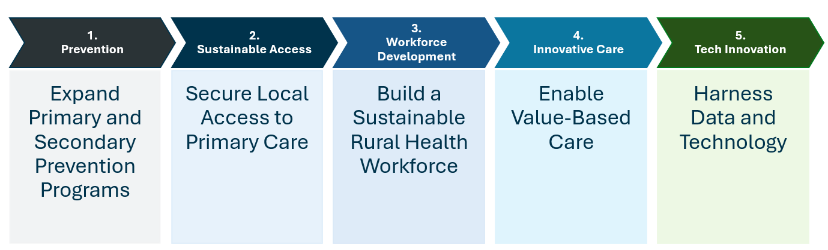
Kansas Plan Initiatives
Multiple programs under each initiative to achieve specified objectives
Programs based on submissions from multiple stakeholders
Intense focus on transformative impact, post-award sustainability
Detailed explanation of the Plan and its programs available at https://www.kdhe.ks.gov/2361/Rural-Health-Transformation-Program

Slide 6
Funding Restrictions
Administrative expenses capped at 10% of total funding in given budget period
Cannot use funds for new construction
Capital expenditures capped at 20% of total funding in given budget period
Cannot pay for clinical services presently reimbursable by insurance
Payments for non-reimbursable clinical services capped at 15% of total funding in given budget period
Cannot change payment amounts on existing fee schedules
Cannot pay specialist located in urban area to provide telehealth services for rural residents
Cannot purchase food
EHR replacement capped at 5% of total funding in
given budget period
Cannot back-fill programs that have lost funding
All funded positions subject to federal salary rate limitation
Cannot use funds to pay clinician salaries or wage supports for facilities that subject clinicians to non-competes
“Start-up” initiative funding capped 10% of total funding in given budget period
Cannot use funds as expenditure that is attributable to intergovernmental transfer, certified public expenditure, or otherwise finance non-Federal share of expenditures required by law
Other standard restrictions on grant expenditures apply
Notes:
Proposed plan initiatives were scored based on:
Strategy – how much the investment would impact transformation
What was the proposed workplan and monitoring/oversight
What were the expected outcomes
What would be the projected impact on rural residents
What is the sustainability

Slide 7
Kansas Plan Implementation
Governor designated KDHE as lead agency for Plan development and implementation
  Governor formed Kansas Rural Health Innovation Alliance to facilitate stakeholder engagement in Plan development and implementation
    Includes leaders from several statewide organizations involved in rural healthcare delivery
    Committed to maximum transparency to facilitate meaningful engagement
  State contracted with The University of Kansas Health System Care Collaborative to provide project management and implementation support
    Decade of experience working with rural providers to implement evidence-based practices, to engage in quality improvement, and to pursue value-based contracting
    91 provider organizations across 79 counties participate, including hospitals in 72 of the 75 rural Kansas counties with hospitals, along with affiliated clinics
  Multiple organizations engaged in implementing specific programs and projects
Must adhere to detailed implementation plan and timeline and comply with CMS program requirements

Slide 8
Budget Year 1 (BY1)
December 29, 2025
Notice of Award for BY1
January 30, 2026
Revised BY1 Budget due to CMS
August 30, 2026
Annual report + BY2 funding request due
October 30, 2026
BY1 ends; all BY1 funds must be obligated
(use or lose)
By October 31, 2026
BY2 funding announced
By September 30, 2027
All BY1 funds must be expended
(use or lose)
July 31, 2026
End of first reporting period
Q1 2026
Initial BY1 funds available to State for authorized expenditures
Future funding tied to satisfactory progress on workplan implementation

Slide 9
Six Priority Programs
Statewide Impact + Speed to Implementation
Value-Based Incentive Payment Program (included under Initiative 4)
  Quarterly payments to hospitals ($50K) and clinics ($25K) for employing evidence-based practices
  Includes ongoing education and assistance to ensure success
Regional Partnership and Transformative Capital Investment Grant Programs (included under Initiative 2)
  Competitive grants to fund collaborative arrangements and capital investments
  Anticipate Year 1 awards totaling $60 million for rural providers to transform local care delivery
Accountable Food is Medicine + Community Health Worker (CHW) Deployment (included under Initiative 1)
  Promote healthy eating and exercise to prevent and manage chronic disease
  200 local CHWs to provide ongoing support and coordination of resources

Slide 10
Six Priority Programs
Statewide Impact + Speed to Implementation
Workforce Development (included under Initiative 3)
  Multiple projects ranging from rural residency programs to K-12 career exploration
  Focus on critical shortage areas, including nursing and allied health
Interfacility Transports (included under Initiative 3)
  Dedicated regional teams with equipment to transport rural patients to/from larger facilities
Anchor Hospital Advancement Program (included under Initiative 4)
  Direct assistance to larger rural hospitals to ensure local access to specialty services
  Includes administrative services, technology acquisition, practitioner recruitment

Slide 11
Immediate Next Steps
Submit updated budget to CMS by January 30
Establish internal processes to request, receive, and account for federal funds
Finalize detailed program implementation plans, work assignments, and timelines
Enter into subrecipient and subcontractor agreements for specific programs
Outreach to rural providers and communities regarding opportunities for participation
Release request for applications for Regional Partnership and Transformative Capital Investment Grant Programs in mid-February; announce awards in late May
Secure providers’ commitment to participate in value-based incentive payment program
Establish and empower work groups to launch Food Is Medicine/CHW Deployment
Finalize anchor hospital criteria and secure commitment to participate
Continue engagement with Kansas Rural Health Innovation Alliance

