Slide 1

KLPG Legislative Update with
State Representative
Adam Smith

Slide 2
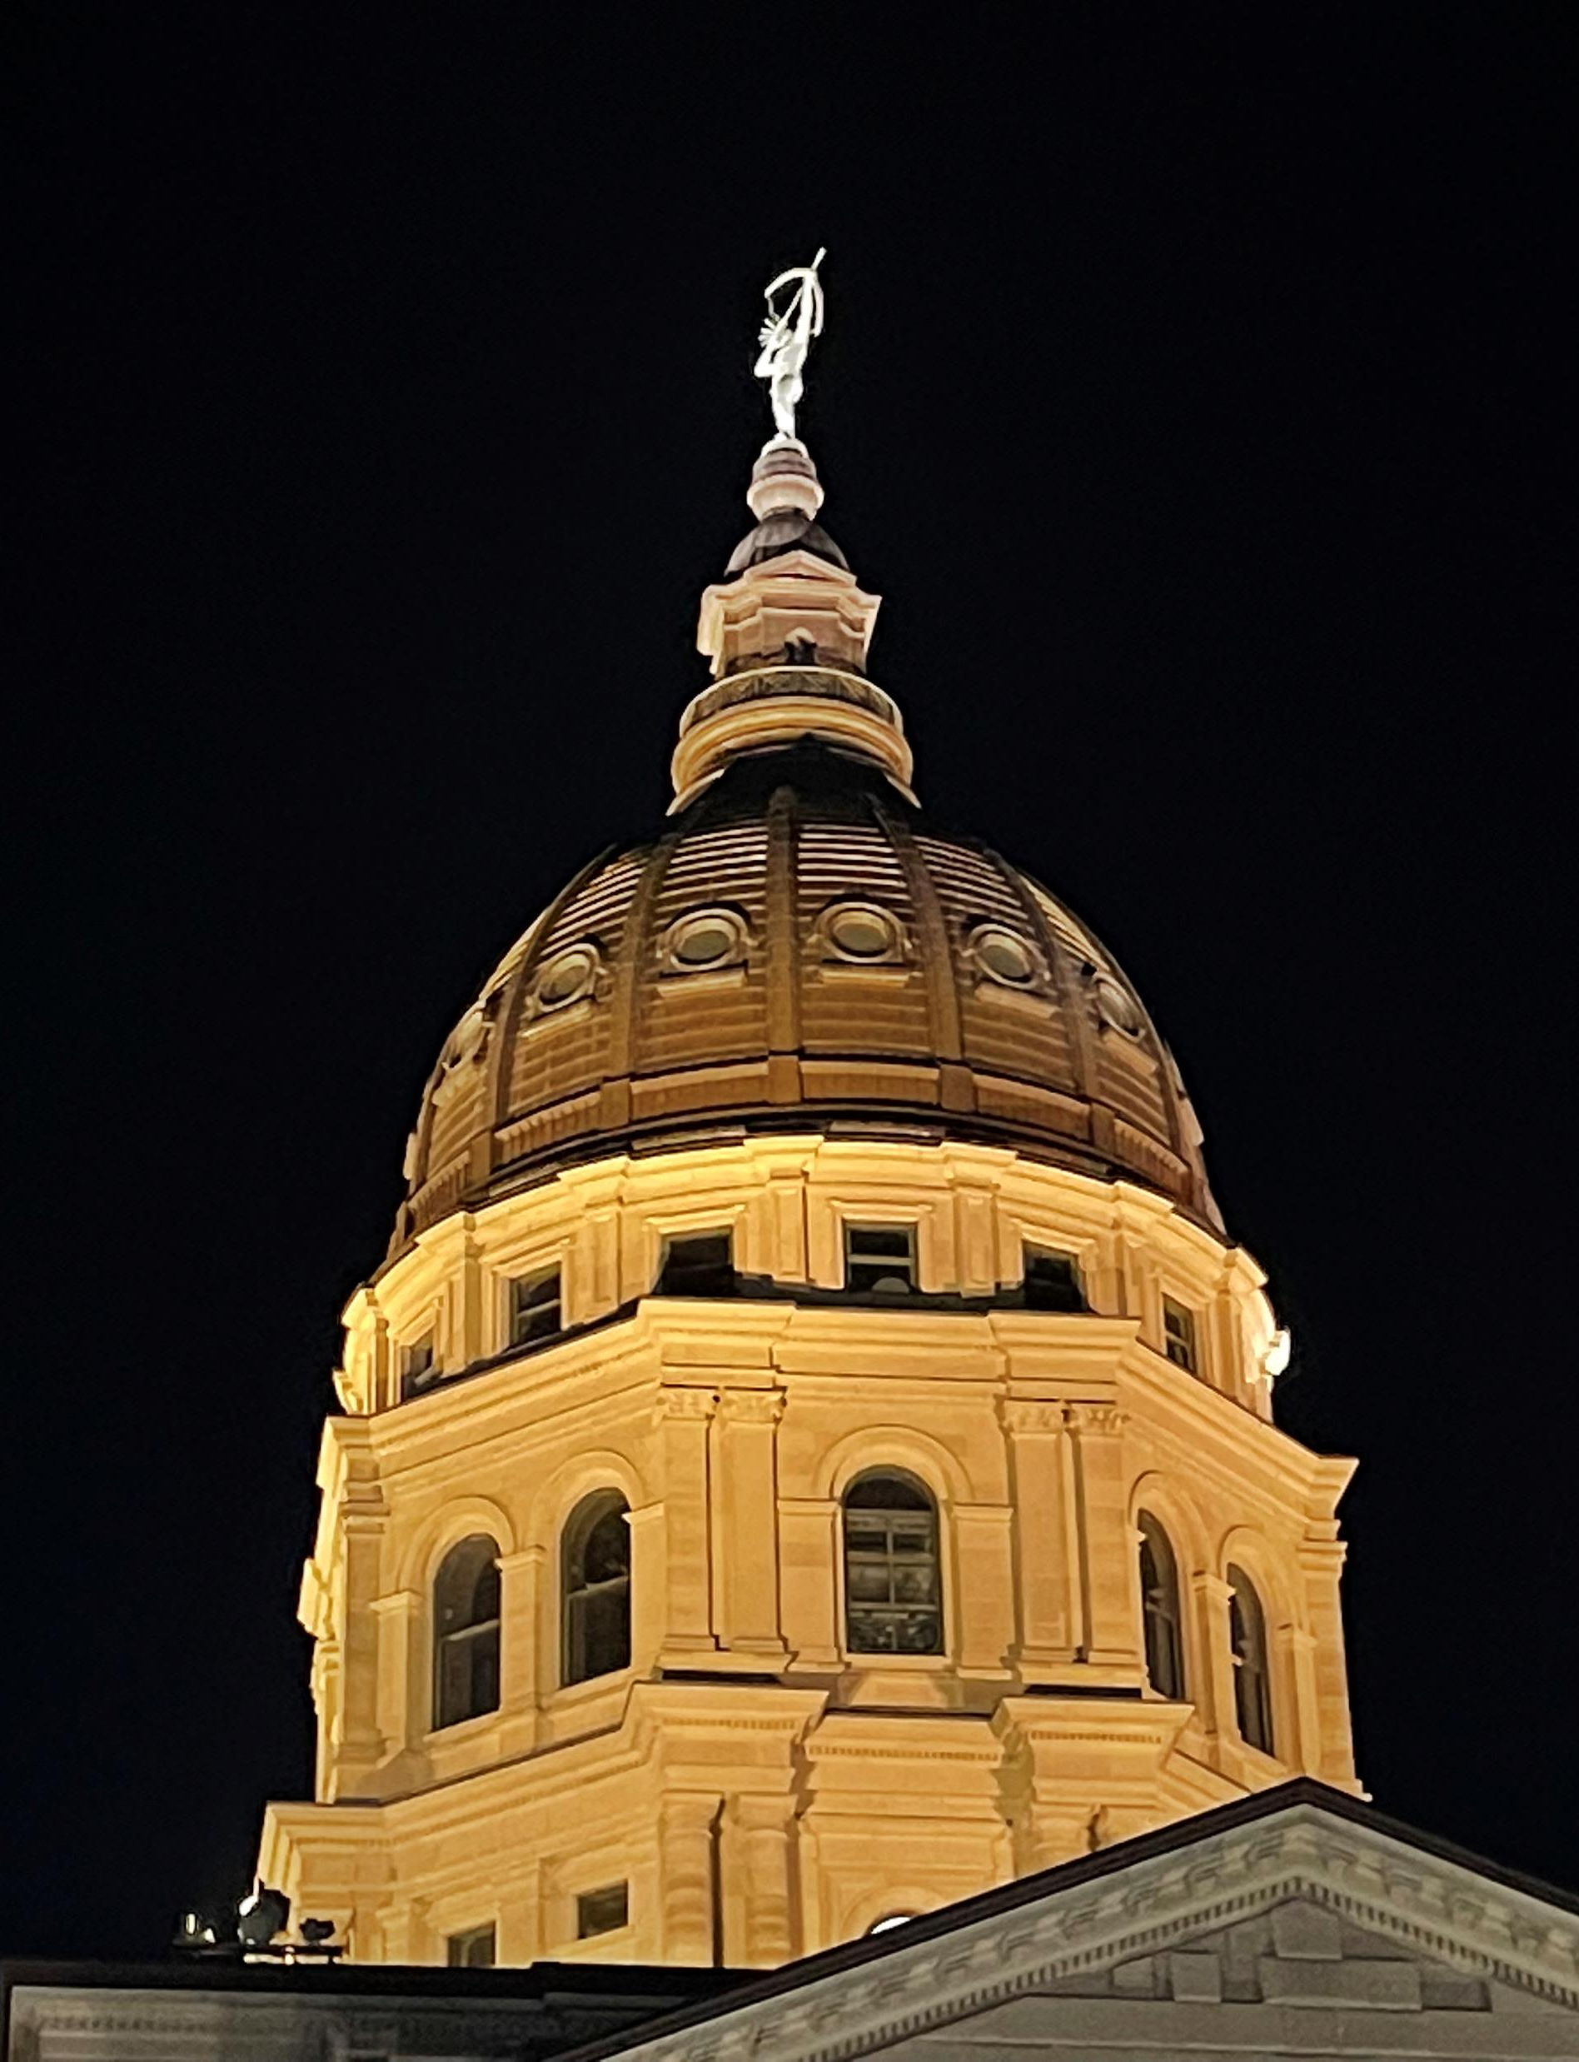

2026 Session

Slide 3
2026 Session
Significant Policies Being Debated:
SCR1616 Valuation cap:
3% limit on assessed value, non-transferable, 2022 rollback, improvements reset to current fair market value
Not equal and uniform
Rollback to 2022 only raises mill levy
Disincentivizes improvements
Appraised value vs Assessed value

Slide 4
Appraised vs Assessed
Cap Appraised Value example:
$100,000 home, increases to $115,000
Appraised Value $115,000
(capped at 3%)
$100,000 x 1.03% = $103,000
Taxable Assessed Value
$103,000 x 11.5% = $11,845
Budget vs Total Valuation
$10M / $92.7M = .107874 mill levy
Property Tax Owed
$11,845 x .107874 = $1,277.77
Cap Assessed Value example:
$100,000 home, increases to $115,000
Assessed Value $100,000
$100,000 x 11.5% = $11,500
Taxable Assessed Value
($13,225, capped at 3%)
$11,500 x 1.03% = $11,845
Budget vs Total Valuation
$10M / $92.7M = . 107874 mill levy
Property Tax Owed
$11,845 x .107874 = $ 1,277.77

Slide 5
Capped vs uncapped
Capped Value example:
$100,000 home, increases to $115,000
Taxable Assessed Value
$11,845 (capped at 3%)
Budget vs Total Valuation
$10M / $92.7M = .107874 mill levy
Property Tax Owed
$11,845 x .107874 = $1,277.77
Uncapped Value example:
$100,000 home, increases to $115,000
Taxable Assessed Value
$115,000 x 11.5% = $13,225
Budget vs Total Valuation
$90M → $92.7M → $103.5M
$10M / $103.5M = .096618 mill levy
Property Tax Owed
$13,225 x .096618 = $1,277.77

Slide 6
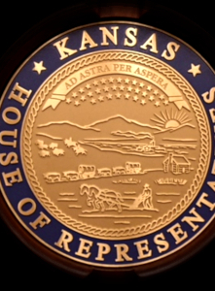
Other Policy
RS3064 – New House plan – similar to HB2396
Allows 3% increase in property tax collected
(adjusted for new construction)
To exceed 3%, must put on ballot Nov. prior
Property Tax Stabilization Fund $60M
only to counties, new distribution:
20% equal ($115K), 40% population,
40% valuation
Revenue Neutral obsolete, moves focus to tax dollars instead of revenue neutral mill levy

Slide 7
Other Policy
HB2440 – Allows county appraisers to grant exemption on low-production wells
HB2406 – CIME exemption removing 2006
HB2011 – Reduction of statewide 20 mill levy
HB2377 – Apportionment of general sales tax
HB2385 – Local govt earnings tax authority
RS2807 – Homestead / SAFESR reform
RS2568 – Removal of Ag Use presumption
RS2487 – County sales tax authority
RSxxxx – BOTA appeal good for 5 years
RSxxxx – New Wind and Solar tax

Slide 8
Thank
You!
Adam Smith
785-821-2568 cell

